Slide 1
Adoption Of Open Standards
Shahina Anwarul
sanwarul@ddn.upes.ac.in

Slide 2
Benefits Of Open Standards
Interoperability
Prevents vendor lock-in
Flexibility
Collaborative innovation
Lower cost
Freedom of action

Slide 3
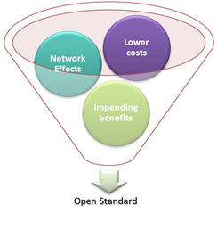
Drivers For Adoption

Slide 4
Network Effects
The network effect is a phenomenon whereby a good or service becomes more valuable when more people use it.
When the network effects are present, the value of the goods or service increases as the number of users grows. It is sometimes referred to as Network Externalities or Metcalfe’s law.
The classic example of the network effect is telephone, Internet, Facebook etc., the more people own telephones, the more valuable telephone to each other. Similarly, the more users come online on Facebook, the network becomes more valuable as the user can communicate with more people.
The same analogy holds good for adoption of open standards as well.

Slide 5
Lower Costs
One of the challenges that most organizations face today is the procurement and maintenance costs of the single vendor products.
Open standards prevents vendor lock-in by making the specifications available at a nominal prices.
Also, during business expansion, multiple products can interoperate with minimal changes to the existing infrastructure rather than spending enormously in rebuilding the infrastructure.

Slide 6
Impending Benefits
The compelling benefits of adopting open standards are numerous.
Primarily, the interoperability between systems and preventing vendor lock-in attracts the businesses and governments to adopt open standards.
The other benefits include flexibility, freedom of action, lower cost and collaborative innovation.

Slide 7
Adoption Methods And Process
When there is a need to set a standard in the market/industry sector, the National Standards Body (NSB) of the respective country performs the feasibility check on the existence of a national, or regional or international standard that meets the market requirement. If yes, the NSB adopts the existing standard otherwise, a new standard is defined.
When a NSB decides to adopt a national standard from another NSB, an agreement has to be reached prior to the adoption.
When a NSB decides to adopt an international standard, the standard can be adopted “As-Is” or with modifications based upon the degrees of association.

Slide 8
Degrees Of Association
The degrees of association define the extent of deviation of the national standard in relation to the international standard.
Identical (IDT)
Modified (MOD)
Not Equivalent (NEQ)

Slide 9
Identical (IDT)
The national standard is identical to the international standard when the technical content, wording and structure are identical in nature or minor editorial changes exists between the two.
The variations can be misprints or deletion of text belonging to other languages, usage of synonyms or substituting a decimal point with a coma etc.

Slide 10
Modified (MOD)
The national standard is modified in relation to the international standard when there is a little deviation in the technical content, wording and structure between the two.
The technical deviations are allowed provided they are clearly stated and explained.
The deviation can be that the national standard applies only the subset of the choices available in the international standard or additional text is added to meet certain requirements (like additional tests to be done).

Slide 11
Not Equivalent (NEQ)
There is no or very little match with the technical content, wording and structure between the national standard and the international standard.
This association does not constitute an adoption.

Slide 12
Methods
Endorsement Method
Republication Method

Slide 13
Endorsement Method
When a NSB declares an international standard as national, an “endorsement notice” may be issued.
The notice reference the international standard that is being adopted.
This method is applicable for identical adoptions only.

Slide 14
Republication Method
There are three ways of republication namely – Reprinting, Translation and Redrafting.
Whenever there are few minor changes involved, reprinting the full text is the recommended method of adoption.
Whenever there are lot of changes involved, redrafting the full text is the recommended method of adoption.
But, redrafting may not be a recommended method because the degree of the association between the national and the international cannot be easily determined.

Slide 15
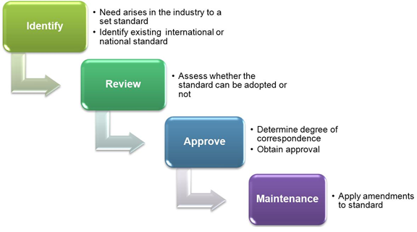
Process

Slide 16
Identify
Whenever a need to set a standard becomes evident in an industry due to market conditions, the industry reaches out to the National Standards Body (NSB).
The NSB performs a standard search to identify the existence of an equivalent national or international standard.
Based upon the result of the search, the NSB decides to either adopt the existing standard or consider creating a new one.

Slide 17
Review
At this stage, the international or national standard identified in “Identify” stage is assessed and validated against the business requirement.
The following questions can be considered during the assessment:
Is the identified standard Open or Closed?
If the identified standard is closed, is it a de facto standard of the industry? If no, it is not recommended for adoption.
If the identified standard is open, is it effectively practiced in other countries?

Slide 18
Review
Is the standard interoperable with other organization standard? Regardless of whether the standard is open or closed, it is critical that the standard is interoperable with the standards existing within the organization that is deciding to adopt the standard. Unless there is a compelling business need, it is not advisable to adopt the standard that is not interoperable.
What are the potential risks and benefits with the adoption of the standards? The benefits and risks have to weigh against each other. When the benefits out weighs the risks, the standard is recommended for adoption.

Slide 19
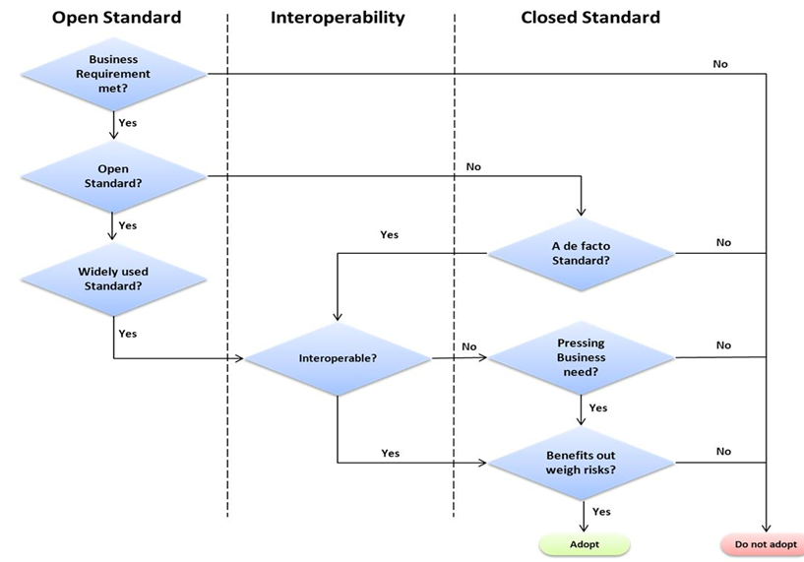
Review

Slide 20
Approve
A review meeting is held to finally decide whether the identified standard should be approved and adopted.
The degrees of association of the national standard in relation to the international standard are determined.
If the variation exists between the national and the international standard, the deviations are clearly stated.
The appropriate method of adoption is applied as described in the previous section and the standard is published for industry use.

Slide 21
Maintenance
The amendments made to the international standard or the revision of the international standard should be reflected in the national standard as early as possible in order to maintain the equivalence of the technical content, wording or structure of the standard.

Slide 22
Real World Examples Of Adoption Of Open Standards
SCOSTA (Smart Card Operating System Standard for Transport Application)
Web Standards

Slide 23
SCOSTA (Smart Card Operating System Standard For Transport Application)
With the growing number of vehicles on the Indian roads, there was a need to stream line the issue of licenses and vehicle registrations certificates process in the different states.
Therefore, each of the Indian state governments came up with different solutions that were based on smart card technology using proprietary standards.
As a draw back of using different solutions and proprietary standard, the licenses issued in one state was not readable or writable in another state.

Slide 24
SCOSTA (Smart Card Operating System Standard For Transport Application)
To address the above interoperability issue, the Ministry of Transport and Highways commissioned the National Informatics Center to make the smart card interoperable with the systems( software or hardware) being used by different state governments.
As a result an open standard, Smart Card Operating System Standard for Transport Application (SCOSTA) was evolved.
The SCOSTA standard was developed by National Informatics Center (NIC) along with academia (IIT Kanpur) and Industry players. The SCOSTA standard is managed by NIC.

Slide 25
SCOSTA (Smart Card Operating System Standard For Transport Application)
The SCOSTA open standard is based upon the international standard ISO/IEC – 7816.
The standard is managed jointly by International Organization for Standardization (ISO) and the International Electrotechnical Commission.
The ISO/IEC – 7816 is a series of standards related to identification cards (such as smart cards) intended for information exchange agreed with the outside world and the integrated circuit built within the card.
The information exchange can be in the form of data retrieved from the card or data stored into the card.

Slide 26
SCOSTA (Smart Card Operating System Standard For Transport Application)
The SCOSTA standard is made royalty-free and its specifications are available in the NIC website http://www.scosta.gov.in/.
The Ministry of Transport and Highways rolled out the SCOSTA standard nationally.
The number of vendors providing cards and card readers increased significantly.
The smart cards provided were interoperable across states and were available at competitive prices.
Earlier, there were only four or five foreign companies who were making smart cards.

Slide 27
SCOSTA (Smart Card Operating System Standard For Transport Application)
With the adoption of SCOSTA, more than a dozen Indian companies came forward and bid for projects in this sector.
The increased competition impacted the prices of the smart cards.
The cards which were priced at INR 300 were now available at INR 30.
The adoption of SCOSTA standard has helped the Indian government to reap monetary savings estimated in billions considering the population and vehicle density in India.

Slide 28
SCOSTA (Smart Card Operating System Standard For Transport Application)
Considering the success story of SCOSTA standard adoption by the Ministry of Transport and Highways, the Ministry of Home Affairs are piloting the Multi purpose National Identity Card (MNIC) project implementing the SCOSTA standard.
The MNIC project is being implemented in 20 locations in 12 states and one Union territory.
Also, the Ministry of External Affairs is implementing the pilot project of e-Passports using the SCOSTA specifications.

Slide 29
Web Standards
Few decades ago, people solely depended upon books for information.
The book houses and libraries were flooded with people seeking information.
People used to spend hours in libraries searching for relevant information; sometimes disappointed either due to the unavailability of the book in the library or the book was not allowed to be rented.
This has become history now with the evolution of Internet.
What has enabled the widespread usage of internet in the recent days?

Slide 30
Web Standards
How the information is made available on click of a button?
Who has written all the information that is available today?
Is it a contribution of a single individual or a group of people?
The answer to all the above questions is “Open Web Standards”. Hyper Text Markup Language (HTML) is one of the open web standards that have made the information available on the web so easily.
The web open standard, HTML was defined by Tim Berners-Lee in late 1991.

Slide 31
Web Standards
The standard has undergone several revisions since its inception.
The standard is being managed by World Wide Web Consortium, which is an international community where Member organizations, a full-time staff and public work together to develop web standards.
HTML is a markup language that is used to create web pages.
It is a specification that is used to structure information or content to create a web document.
The web browsers use this language to interpret and render text and images into audible and visual web pages. It is a very simple language and easy to use.

Slide 32
Web Standards
The books are available on line today without the need to pay or visits to the library.
The newspapers are available on line today.
The news such as cricket score or temperature of a city is available on demand.
Opinions on a certain topic are shared via blogs. Wikipedia is available to provide brief information on a relevant topic.
The web standards have enabled the access to the information quicker.

